Slide 1

Predicting Crime Patterns in Switzerland to 2030
Demographic and Offence Trends

Slide 2
The dataset "Swiss Criminal Code (SCC): Offences and Accused Persons" Federal Statistical Office (FSO)
From 2009 to 2023
253 types of offences ranging from homicide to petty crime
Demographic information includes: sex, age group and nationality
The number of offences total, legal or natural persons
Notes:
This project focuses on analyzing criminal offence data in Switzerland. The dataset namely "Swiss Criminal Code (SCC): Offences and Accused Persons“, was downloaded from the Federal Statistical Office (FSO) and spans from 2009 to 2023. The dataset provides the demographic information of the accused individuals across Switzerland for a multitude of criminal offences.
By applying machine learning models to this dataset, we aim to predict the number of offences that will may occur up until 2030, specifying what the likely demographic will be.

Slide 3
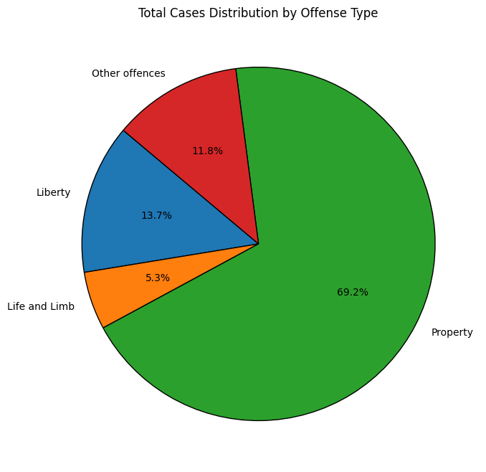
Offence by type

Slide 4
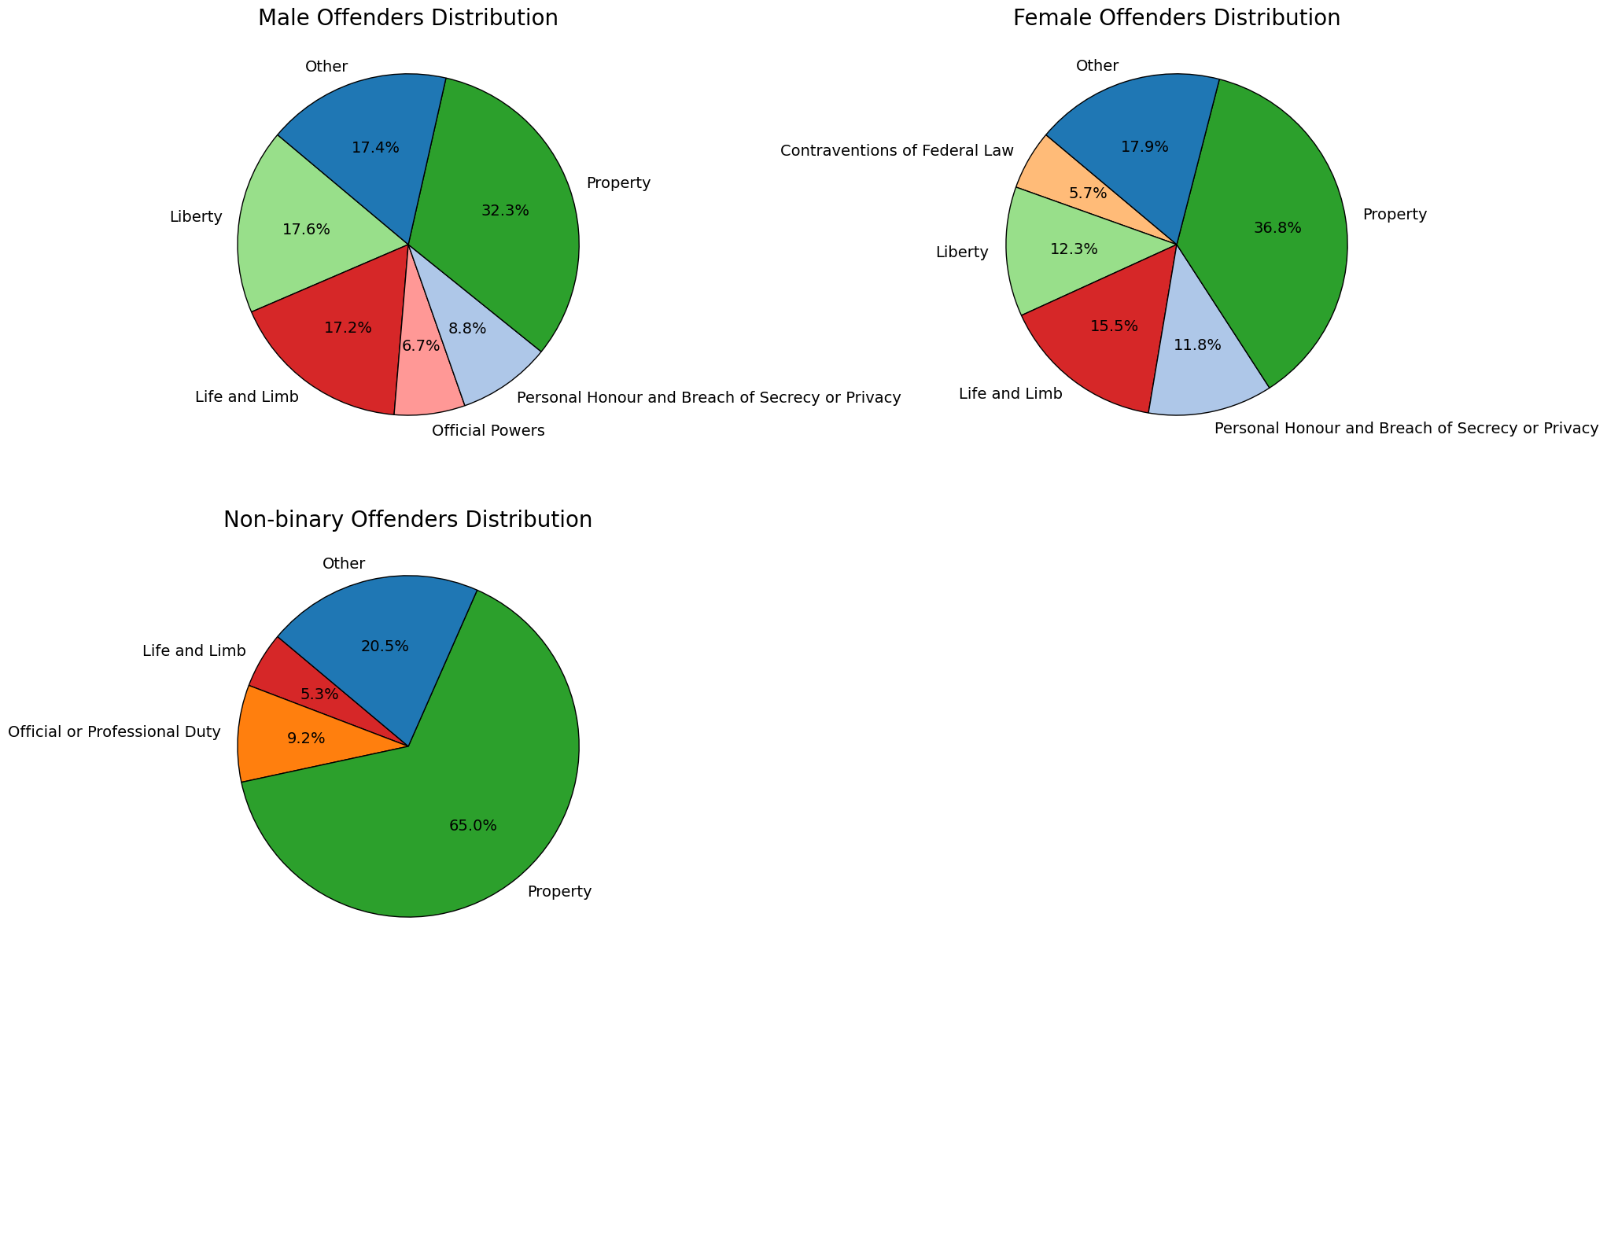
Offences by sex

Slide 5
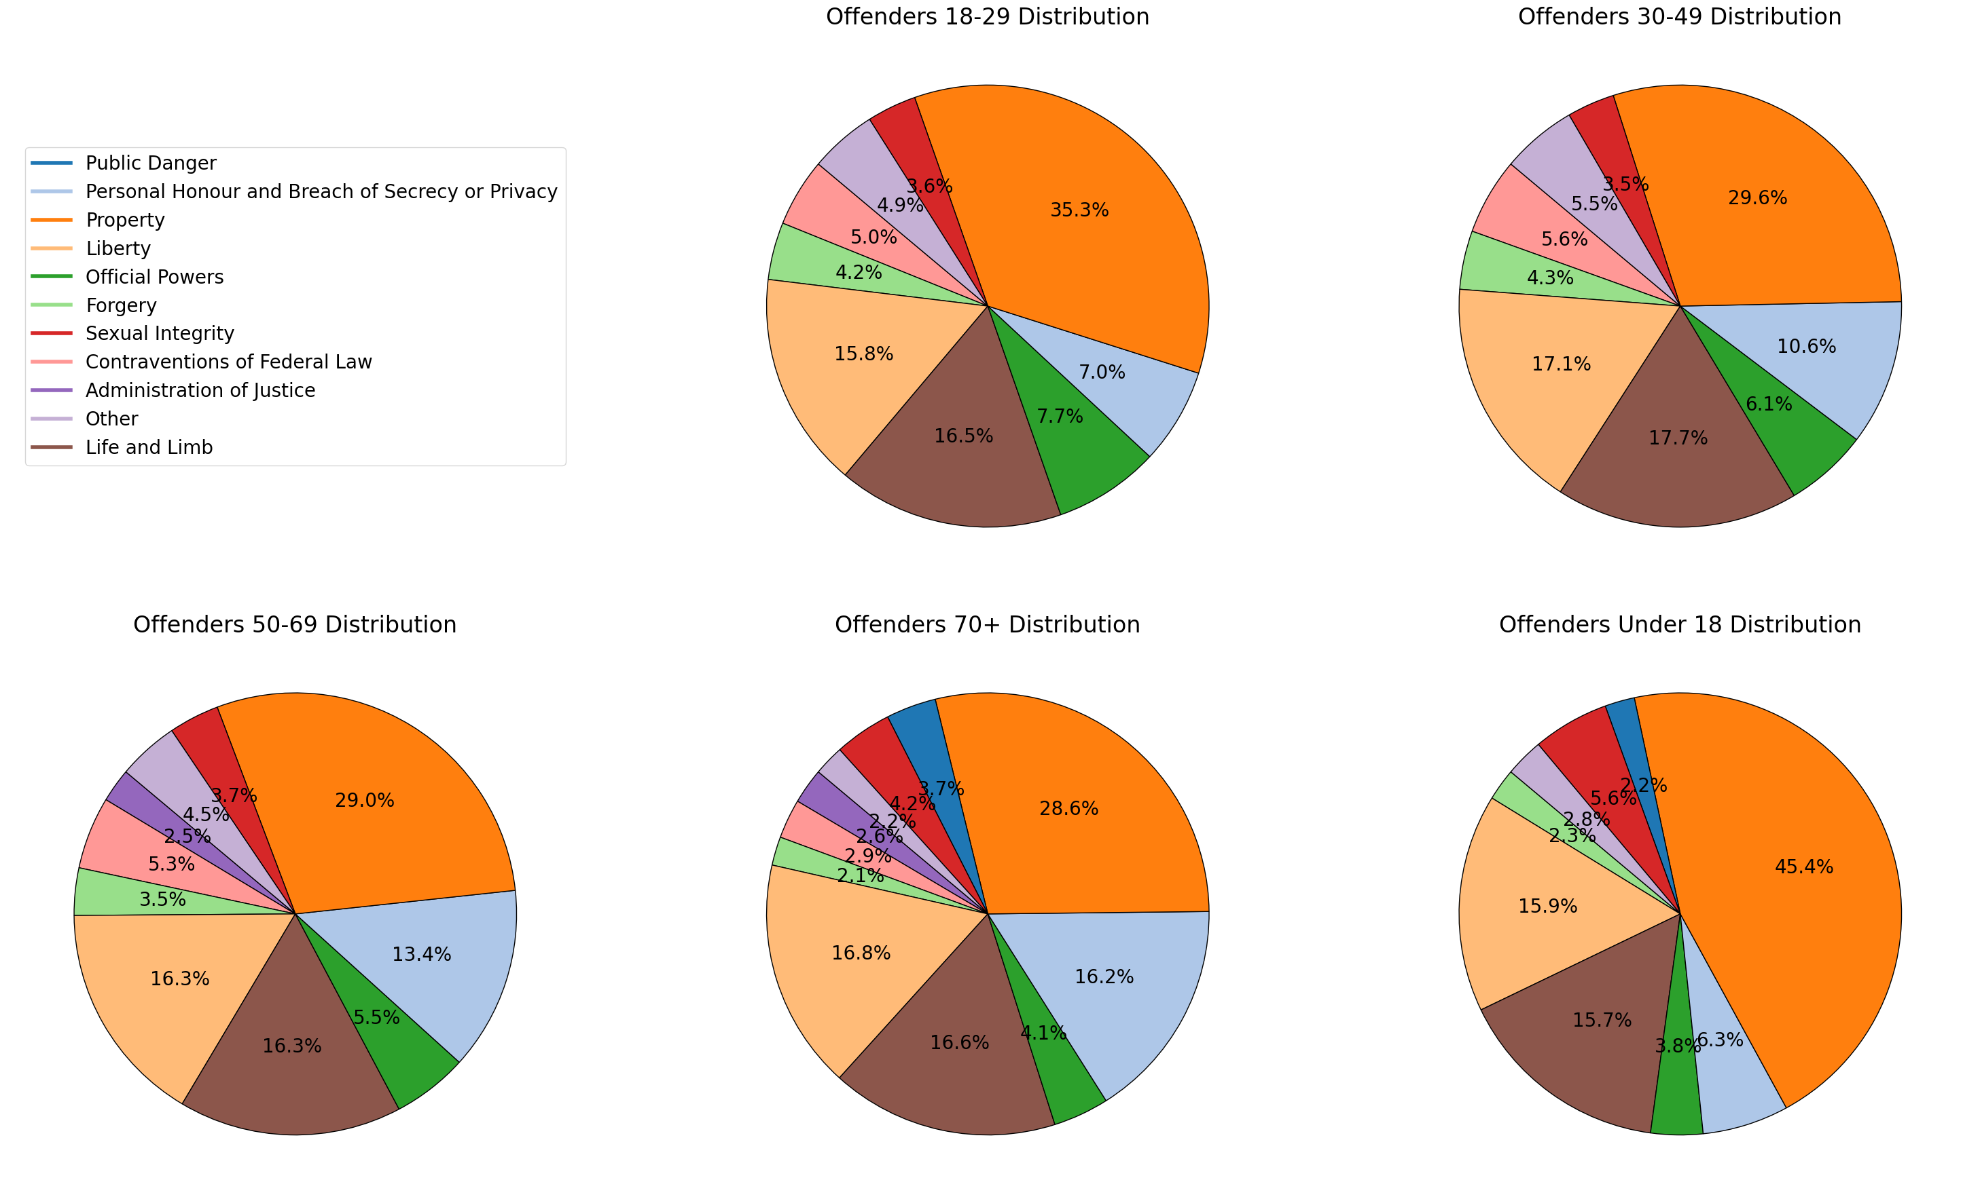
Offences by age

Slide 6
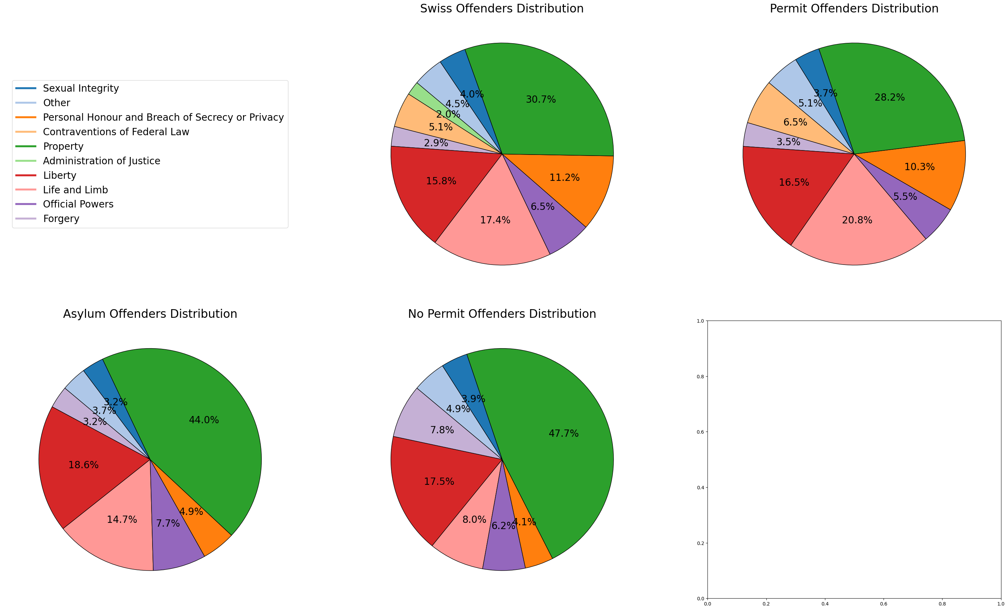
Offences by nationality

Slide 7
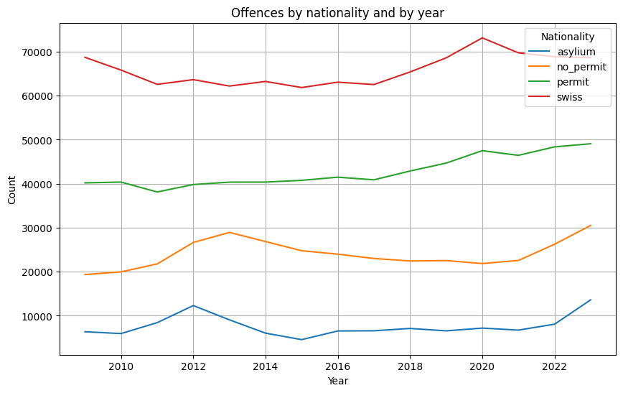
Offence count by nationality and year

Slide 8
Model evaluation
Model: Multiple Linear Regression
MSE: 211.33890632505162
MAE: 0.7779906195448597
R2: 0.999997237594011
Model: Decision Tree Regressor
MSE: 527177.1833810888
MAE: 122.78510028653295
R2: 0.9931092791481954
Model: Random Forest Regressor
MSE: 525705.8326451291
MAE: 114.91276504297997
R2: 0.9931285111398601
Model: XGBoost
MSE: 179109.52163042905
MAE: 82.23713884455063
R2: 0.9976588635579029
22/22 ━━━━━━━━━━━━━━━━━━━━ 0s 3ms/step
MSE: 944370.2747678702
MAE: 316.48012517473757
R2: 0.9876561578359068
1
4
3
2
5
Artificial Neural Network (ANN)
Notes:
Multiple Linear Regression
Very low MSE and MAE indicate high prediction accuracy.
R² value close to 1 suggests a near-perfect fit, implying minimal residuals and excellent prediction performance.
Decision Tree Regressor
Higher MSE and MAE compared to Multiple Linear Regression, indicating lower accuracy.
R² value is still quite high, suggesting the model captures general trends well but lacks precision compared to linear regression.
Random Forest Regressor
Similar performance to the Decision Tree model, but slightly better MAE.
Random Forest improves stability and reduces overfitting compared to a single Decision Tree, though precision remains lower than Multiple Linear Regression.
Gradient Boosting Regressor (XGBoost)
Significantly better MSE and MAE compared to the Decision Tree and Random Forest models, suggesting better precision.
R² value remains high, indicating a strong model fit. This model performs closer to the Multiple Linear Regression model but shows improvements in residual prediction error over Decision Trees.
Artificial Neural Network (ANN)
The ANN model performed notably worse, suggesting it may have struggled to capture the data patterns or suffered from inadequate tuning.
Multiple Linear Regression:
While this model has incredibly low error metrics, the nearly perfect R² value raises concerns about overfitting.
Decision Tree: This model seems to have the highest MSE and MAE, suggesting that it's overfitting and not generalizing well.
Random Forest: Slightly better error metrics than Decision Tree with comparable R², meaning it has a lower risk of overfitting compared to the Decision Tree.
XGBoost: Provides the best error metrics among the complex models, but may require more computational resources and careful hyperparameter tuning.

Slide 9
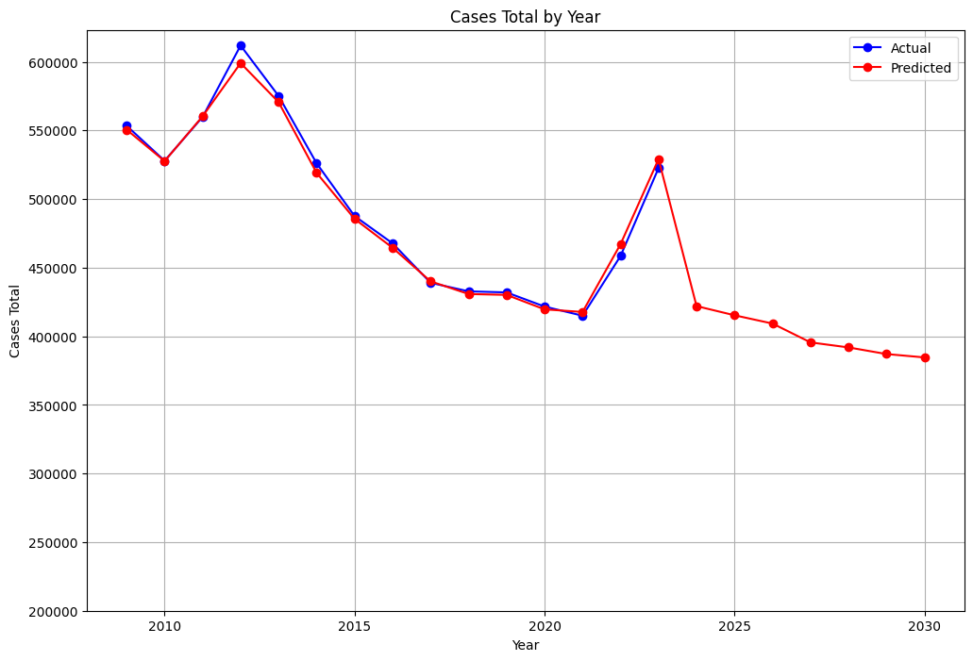
Let's predict the future ! model : Random Forest Regressor
Notes:
model = Random Forest Regressor

Slide 10
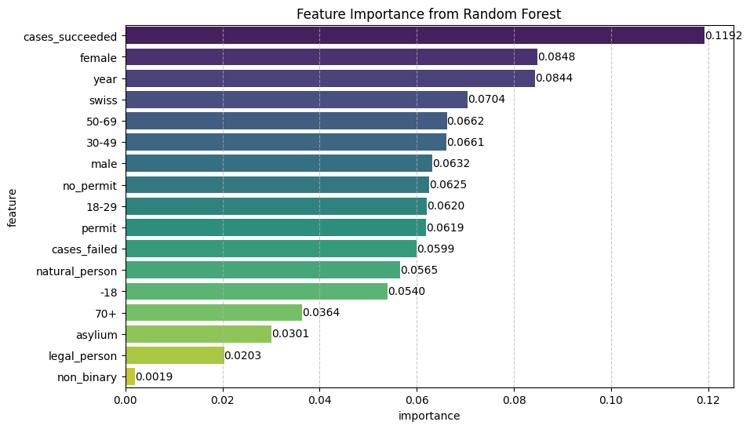
Which features have the highest importance?
Notes:
A high feature importance means that the feature is very useful for the model to predict whether or not an offence occurs (or what type of offence occurs).
It does not mean that the feature itself directly leads to more offences or that there is a causal link.
To interpret why a feature has high importance, you would need to analyze its relationship with other features and the target variable, ideally with additional statistical and domain-specific insights.

Slide 11
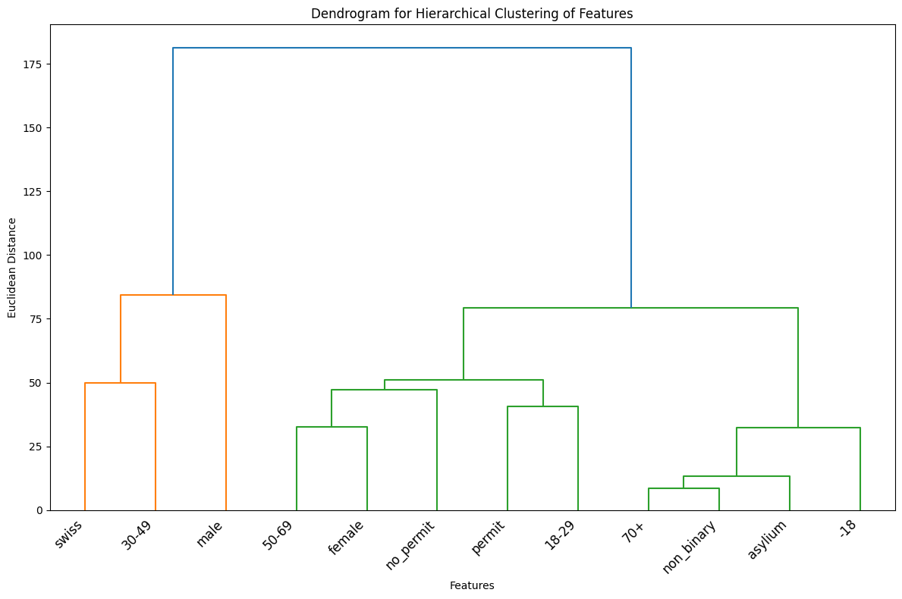
Dendrogram
Notes:
Purpose: This dendrogram visualizes the hierarchical clustering of features based on the number of offenses committed by each group. It highlights patterns in how offenses are distributed across different demographics.
Similarities are determined using Euclidean distance—features that are closer on the dendrogram have more similar offense profiles.
The hierarchical clustering reveals that offenses are not uniformly distributed across demographic groups
.Implication: This insight can help in understanding the characteristics of individuals who are more likely to commit offenses, which may inform targeted interventions or policy adjustments. However, since population size is not accounted for, care must be taken in drawing conclusions regarding per capita offense rates.
2 main clusters

Slide 12
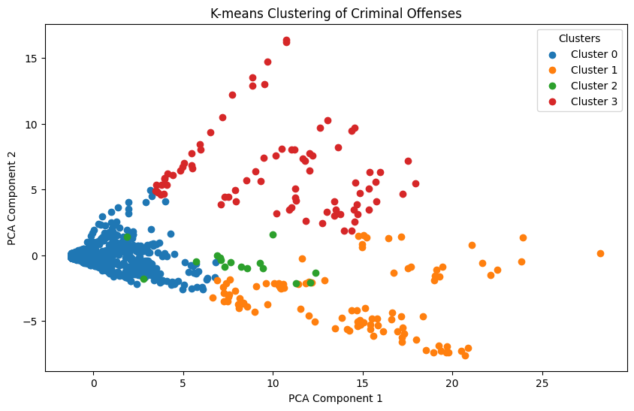
K-means clustering

Slide 13
Discussion
Societal factors that may influence the number of offences per year
Population
Economy
Policing
Demographic
Environment/ situation
Technological change
Law

